Slide 1




GSA Short Course Age-Depth Modeling of Sedimentary Deposits
Session 3
Bacon nitty-gritty, Plum and your own cores

Slide 2
Questions/remarks 1
The session was too rushed
sorry
Provide .Rmd files
done
Resources to understand MCMC
https://towardsdatascience.com/a-zero-math-introduction-to-markov-chain-monte-carlo-methods-dcba889e0c50
How do you account for reservoir correction in marine records while using Bacon?
Add d.R, d.STD columns to your .csv file (see later)
How would you enter U/Th dates and deal with speleothems?
As cal BP, cc=0, assuming normal distribution (or student-t)
Check also Comas-Bru et al. 2020 Earth Syst. Sci. Data doi:10.5194/essd-12-2579-2020

Slide 3
Questions/remarks 2
How to extract batch sedimentation rates for various depths as a text file
Check the .out file, or:
acc20 <- accrate.depth(20)
summary(acc20)
depths <- c(0,3,4,6,7.2, 8, 9, 10, 20:30)
min.acc <- 0; max.acc <- 0; median.acc <- 0
for(i in 1:length(depths)) {
accs <- accrate.depth(depths[i])
minmax <- quantile(accs, c(.025, .975, .5))
min.acc[i] <- minmax[1]
max.acc[i] <- minmax[2]
median.acc[i] <- minmax[3]
}
write.table(cbind(depths, min.acc, max.acc, median.acc), “my_accs.txt”, header=TRUE)

Slide 4
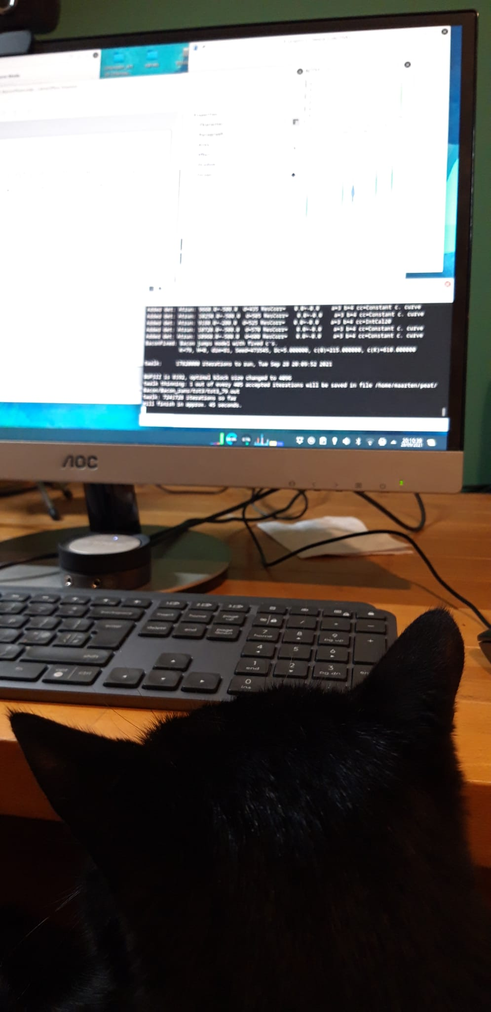
Questions/remarks 3
If the graphs at the top of the RBacon don’t indicate the quality of the model, then why are they provided? From what I understand of graphs, they simply compare the priors to the modeled output, but the modeled output is what matters. If true, then why provide any priors at all? And I don’t understand the concept of “memory”.
Output is partly based on prior!
We’ll look at this in the following slides
How do we tell if the Bacon run was "acceptable" or "needs improvement"?
Partly fit dates/prior, partly our own judgement based on our knowledge
Simulations have shown that Bacon models produce reliable uncertainty estimates
Are there specific commands for incorporating prior knowledge on limiting the age ranges of very young dates, which can have high calibrated uncertainties? For example, prior knowledge that part of an age range is in fact unrelated to the event of interest and shouldn't be incorporated into the age-depth model?
You could set a strong prior on accumulation rate and/or memory

Slide 5
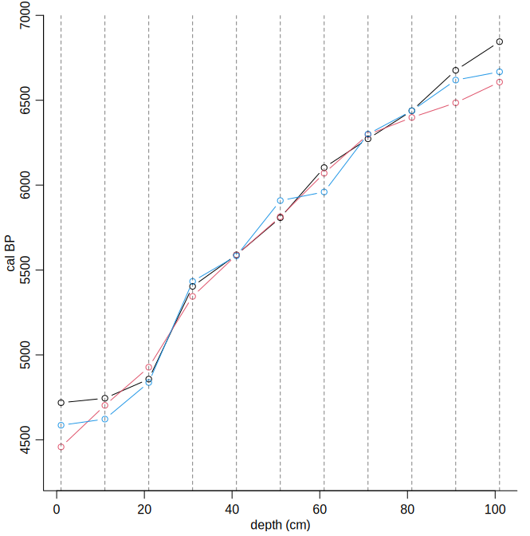
Bacon – The underlying model
Divide a core into K sections of equal width (default Δc = 5 cm), with elbows at c0 < c1 < … cK.
Model the linear accumulation rate xj of section j.
Now we have a piece-wise model that relates depth to age:
Where depth d lies within section i<K (ci < d < ci+1), and θ is the year at c0.
The locations of the dated depths may or may not coincide with the elbows.
$G\left(d,θ,x\right)=θ+\sum_{j=1}^{i}{\left(x_{j}Δc+x_{i+1}\left(d−c_{i}\right)\right)}$
Blaauw and Christen 2011, Bayesian Analysis, doi:10.1214/11-BA618

Slide 6
Priors – Accumulation rate
Bacon’s default 20 yr/cm (mean), 1.5 (shape)
Other sites could could have different rates
E.g., recent sites, older sites, deltas, oceans…
Bacon will do a quick initial check to see if the default prior fits
suggests different acc.rate prior if deemed necessary
or provide your own prior values (mean and/or shape)
The MCMC run will then combine the prior with the new data
updating our information, learning
Goring et al. 2012. Deposition times in the northeastern United States during the Holocene: establishing valid priors for Bayesian age models. Quat. Sci. Rev. doi: 10.1016/j.quascirev.2012.05.019

Slide 7
Priors – Memory
Sets by how much acc.rates can change from one depth to the next
Beta distribution – always between 0 and 1 (0 and 100%)
Defaults: mean 0.5, strength 10
Modelled accrate for section j: xj = w*xj+1 + (1-w)*αj
Where w = memory and α = Gamma(acc.mean, acc.shape)
If w is close to 1, xj will depend a lot on xj+1
If w is close to 0, it will depend very little on xj+1, and mostly on α

Slide 8
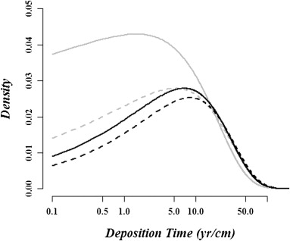
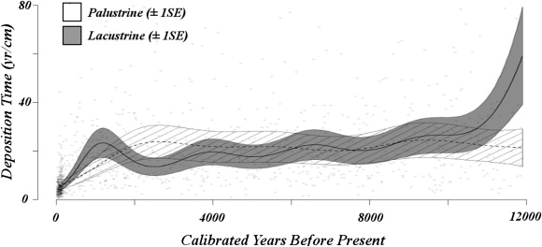
Priors – Accumulation rate
Goring et al. 2012 analysed sedimentation times from classical age-depth models of >200 lakes/tidal wetlands in NE US
Gamma distribution with mean c. 20 yr/cm, shape between >1 and 2
Bacon’s default: mean 20, shape 1.5
Goring et al. 2012. Deposition times in the northeastern United States during the Holocene: establishing valid priors for Bayesian age models. Quat. Sci. Rev. doi: 10.1016/j.quascirev.2012.05.019

Slide 9
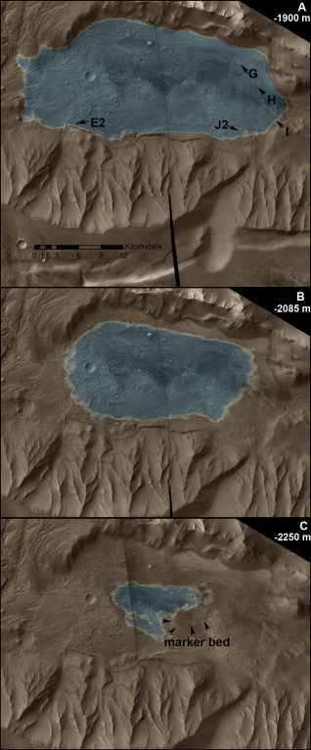
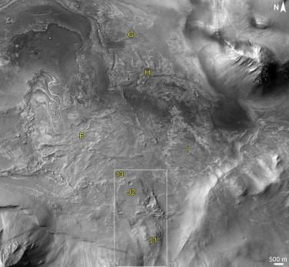
“Lacustrine deposition rates ranged from 0.02 to 1 cm/year over the last 10,000 years in eastern North America (Goring et al., 2012). To accumulate the ∼45 m of layered deposits below fan F using these sedimentation rates would take [4.5–230 ka]. Hence, the presence of lacustrine beds significantly increases the inferred timescale of lacustrine activity within Melas basin.”
Williams and Weitz 2014. Icarus, doi:10.1016/j.icarus.2014.06.030

Slide 10
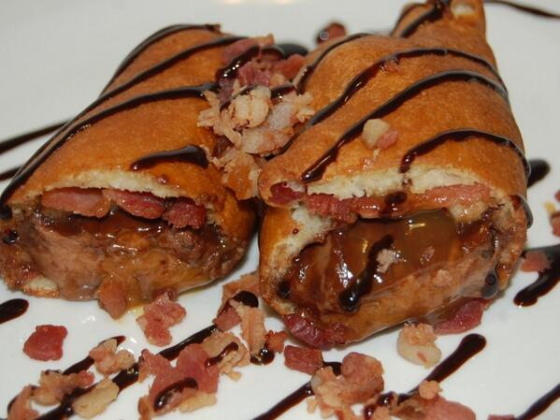
Bacon on Mars?
All we have is the prior information
No new data to learn from

Slide 11
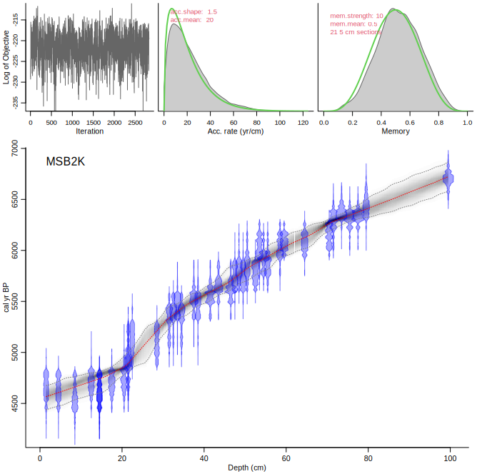
Bacon()
Green: prior distribution
Grey: posterior distribution, which models acc.rates by combining the prior distribution with the dated depths
Not much new has been learned in this case
grey and green overlap for acc.rate and memory
Many data points but no surprises

Slide 12
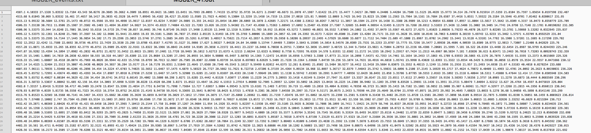
Bacon – .out file

Slide 13
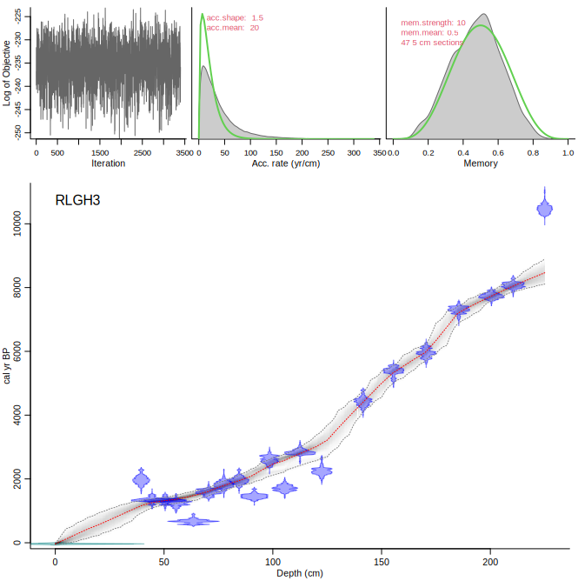
Bacon(“RLGH3”, suggest=FALSE)
Bacon suggested to adapt acc.mean to 50, but we said no.
Prior and posterior accrates differ
But no difference for memory
Lowermost date modelled as outlier

Slide 14
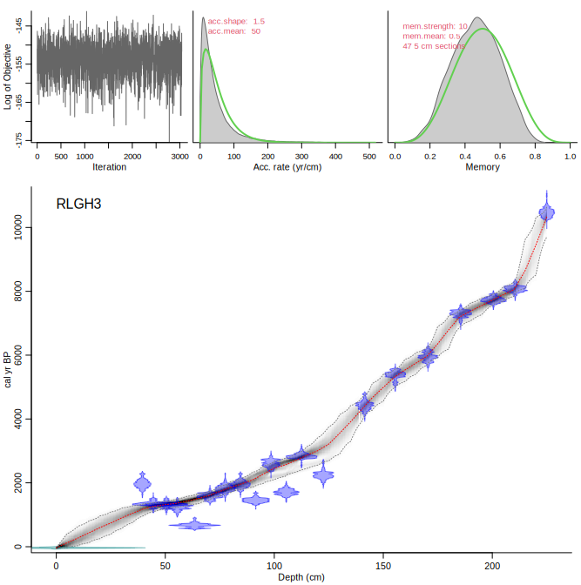
Bacon(“RLGH3”, accept.suggestions=TRUE)
We accept Bacon’s suggestion to adapt acc.mean to 50
Prior and posterior accrates now more similar
Lowermost date not outlying
Memory: posterior overlaps with prior but bit lower
This shows how prior info can be used transparently to bypass some dates, to steer a model
Is the lowermost date outlying or did acc.rate change?

Slide 15
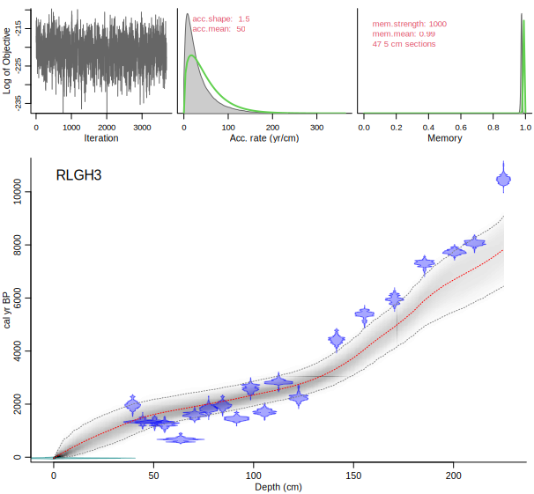
What about that memory thing?
xj = w*xj+1 + (1-w)*αj
Bacon(“RLGH3”, mem.mean=.99, mem.strength=1000)
Yuck!

Slide 16
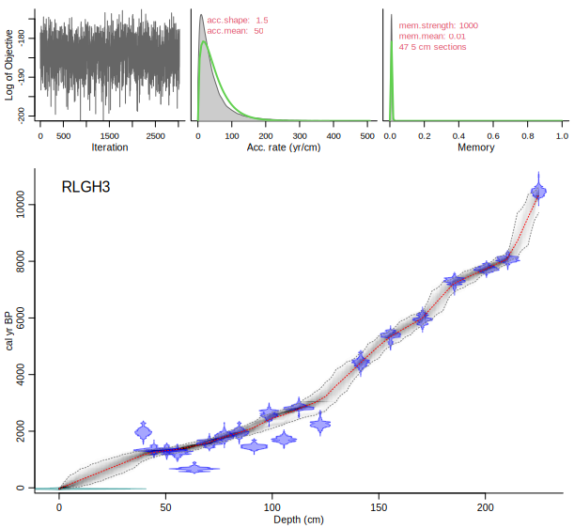
What about that memory thing?
xj = w*xj+1 + (1-w)*αj
Bacon(“RLGH3”, mem.mean=.01, mem.strength=1000)
Not bad…
Recommend to use a permissive prior, mean 0.5 with strength 10 (default)
But robustness tests recommended

Slide 17
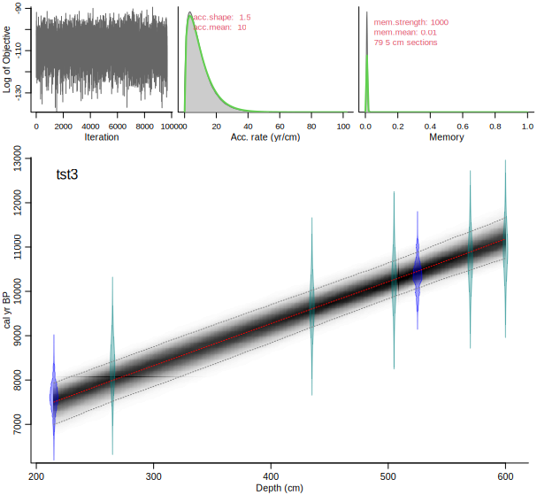
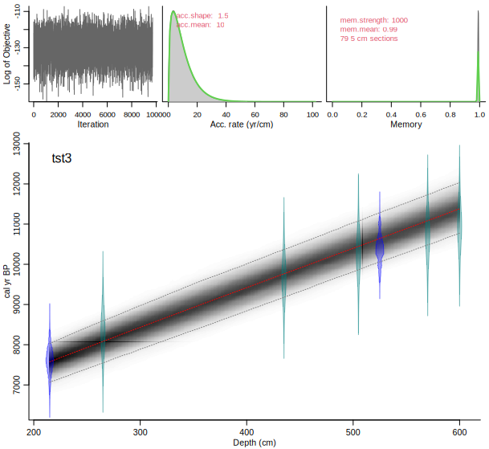
xj = w*xj+1 + (1-w)*αj

Slide 18
Priors – which values to choose?
For reasons of consistency and transparency, use defaults where possible
Or accept the suggested values, and tell so in your paper
If you have more information, you can adapt the priors
e.g., adapt acc.mean for recent lake, Glacial lake
adapt acc.shape if you have strong information about acc.rates (e.g., from a sequence of postbomb dates)
mem.mean: if you expect high variations in acc.rate
mem.strength: if you have strong information about memory
Test a range of priors – your model should be robust to settings

Slide 19
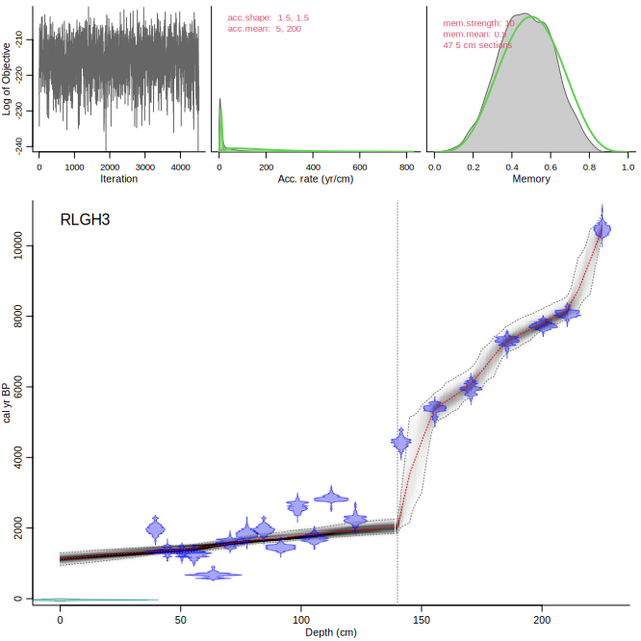
Cores with stratigraphical changes
If you find indications for different accumulation regimes, you can set different acc.rates for the different zones:
Bacon(“RLGH3”, boundary=140, acc.mean=c(5, 200))

Slide 20
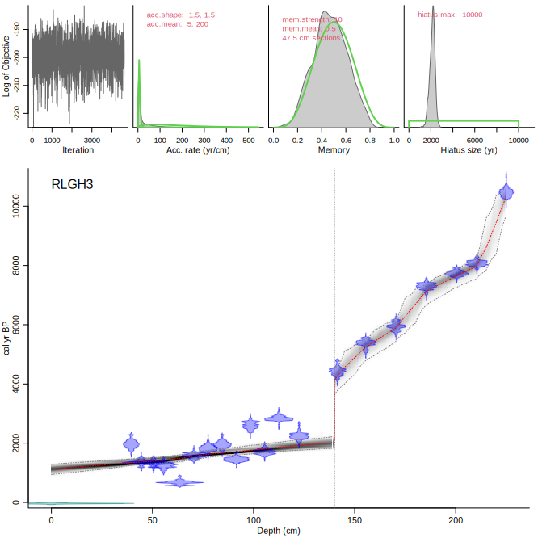
Cores with stratigraphical changes
Or perhaps this was a hiatus:
Bacon(“RLGH3”, hiatus.depths=140, acc.mean=c(5, 200))
Hiatus length prior uniform (max. 10 ka)

Slide 21
Section thickness
Default thick=5 cm
Few sections: too ‘elbowy’
Many sections: too many parameters, model can lose itself
For very long/short cores, different values for thick will be suggested
Also check for robustness of thick
Sometimes it can be handy to set thick to something large for quick age-models (e.g., to check settings for priors). Once you found useful settings, decrease thick again to values that cause a smooth model.
Currently working on finding better suggestions for thick
But 5 cm seems to work fine in many cases

Slide 22
MCMC
Bacon will run millions of MCMC iterations (size depends on ssize and on the amount of core sections)
Using the twalk (Christen and Fox 2010) – walk, traverse, blow, hop
Often, <1% of the iterations will have moved a parameter
After the run, burn-in removed
Thinning to remove dependency between neighbouring iterations
The MCMC plot (‘log of objective’) should show white noise with no discernible structure or features
Can be adapted using thinner() and scissors()
Christen and Fox 2010. Bayesian Analysis doi:10.1214/10-BA603.

Slide 23
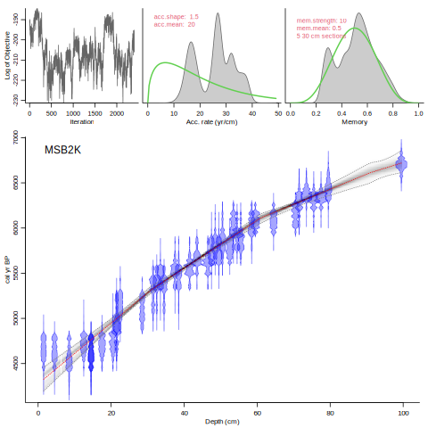
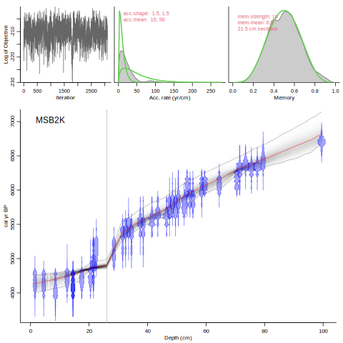
Bacon(, 30)
Bacon( boundary=26, acc.mean=c(10, 50))

Slide 24
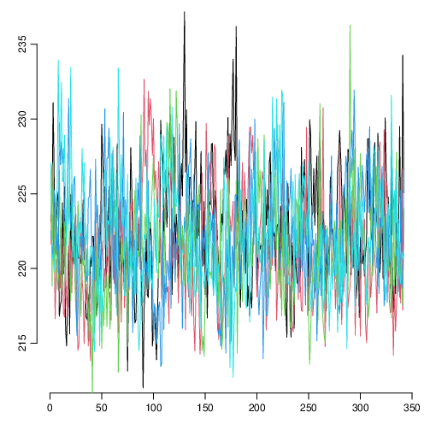
“Did 5 Bacon runs.
Gelman and Rubin Reduction Factor 1.11150186669561 (smaller and closer to 1 is better).
Probably not a robust MCMC run! Too much difference between runs, above the 1.05 threshold. Increase sample size?”
Baconvergence("MSB2K", 5, ssize=100)

Slide 25
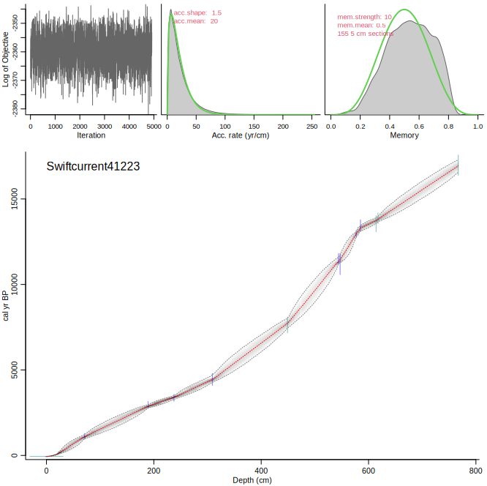
Amy’s cores
Bacon(“Swiftcurrent41223”)
Has a mix of C14 and cal BP dates
Also Pb210 dates

Slide 26
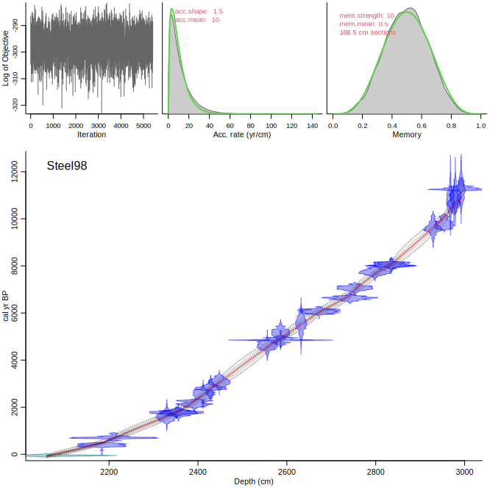
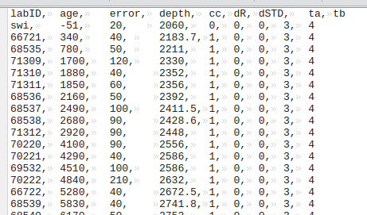
Amy’s cores
Bacon(“Steel98”)
Has additional columns in .csv file

Slide 27
Amy’s cores
Bacon(“Steel98”)
Has additional columns in .csv file

Slide 28
Amy’s cores
Bacon(“Steel98”)
Has additional columns in .csv file

Slide 29
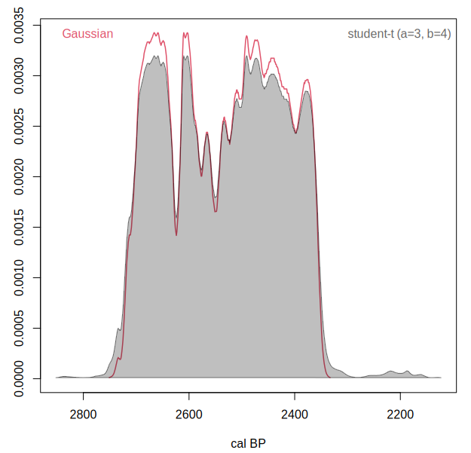
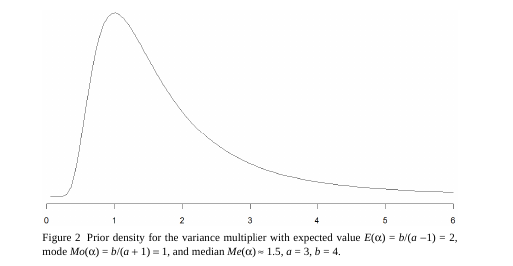
Christen and Pérez 2009. Radiocarbon 3, 1047-1059

Slide 30
Bacon – your own core
For your own core, produce a .csv file with 4 or 5 columns (or more, see manual)
Lab ID, age, error, depth, cc
Put it in a new folder under the umbrella folder:
Bacon_runs/SomeTephraCore/SomeTephraCore.csv
And run it:
Bacon(“SomeTephraCore”)

Slide 31
Bacon – depths
Default every cm from top to bottom depth
d.by=1, can be set to other depths
Or make a variable depths and provide it:
my.depths <- seq(0, 100, by=3)
Bacon(depths=my.depths)
Or place depths as 1 column in a plain.text file
File should end in _depths.txt
Bacon(depths.file=TRUE)

Slide 32
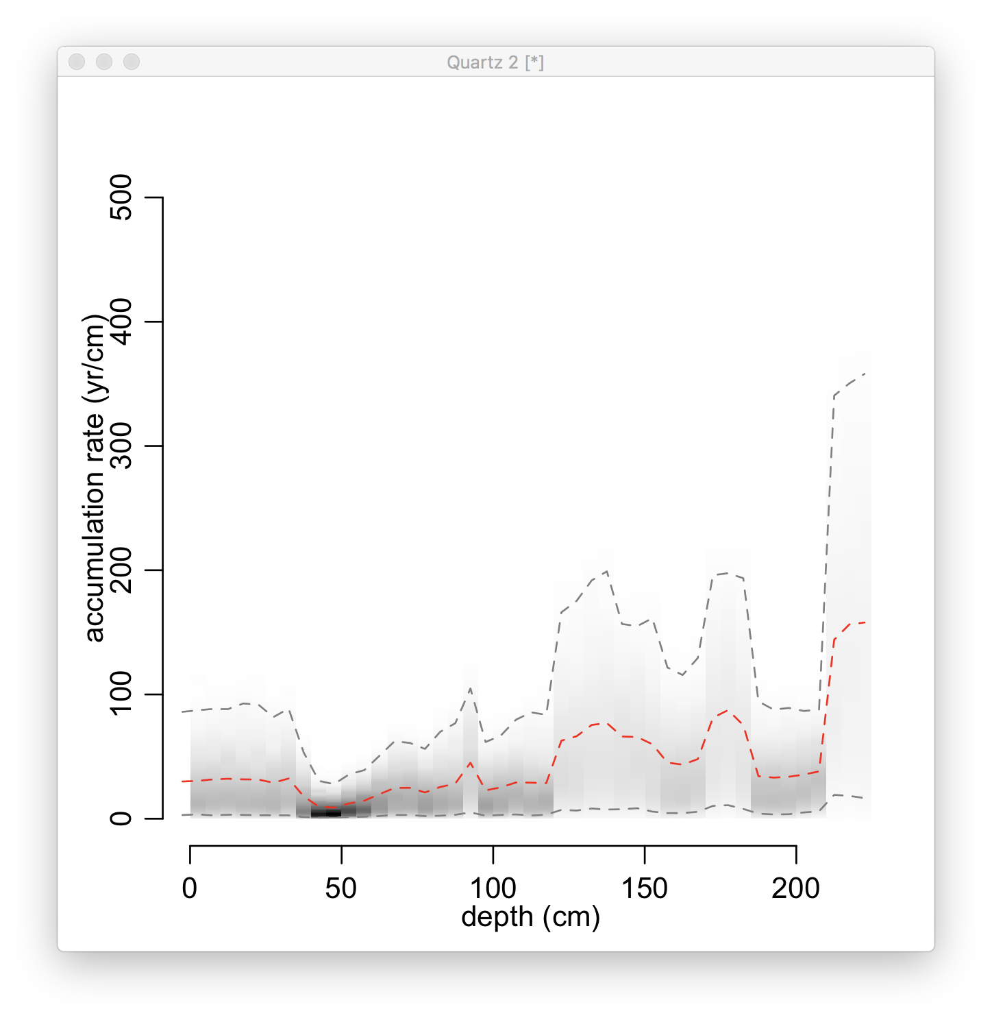
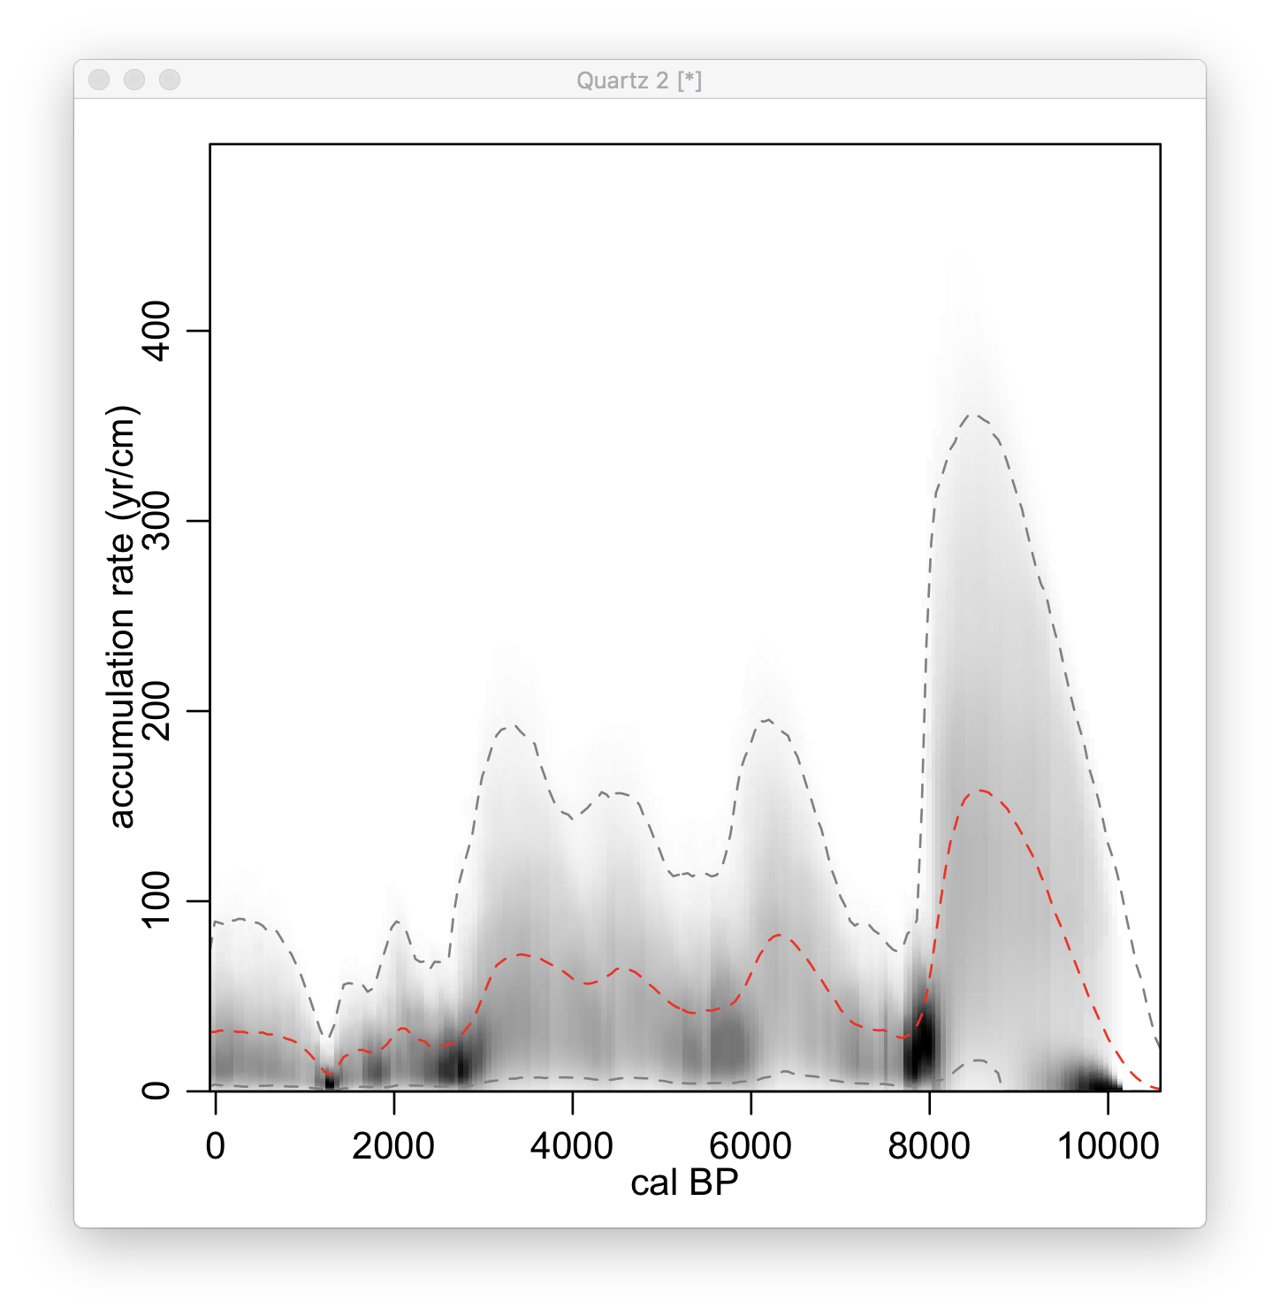
Bacon – post-run analysis
Reload an existing run:
Bacon(“RLGH3”, run=FALSE)
agedepth()
Plot accumulation rate vs depth:
accrate.depth.ghost()
Or against age:
accrate.age.ghost()

Slide 33
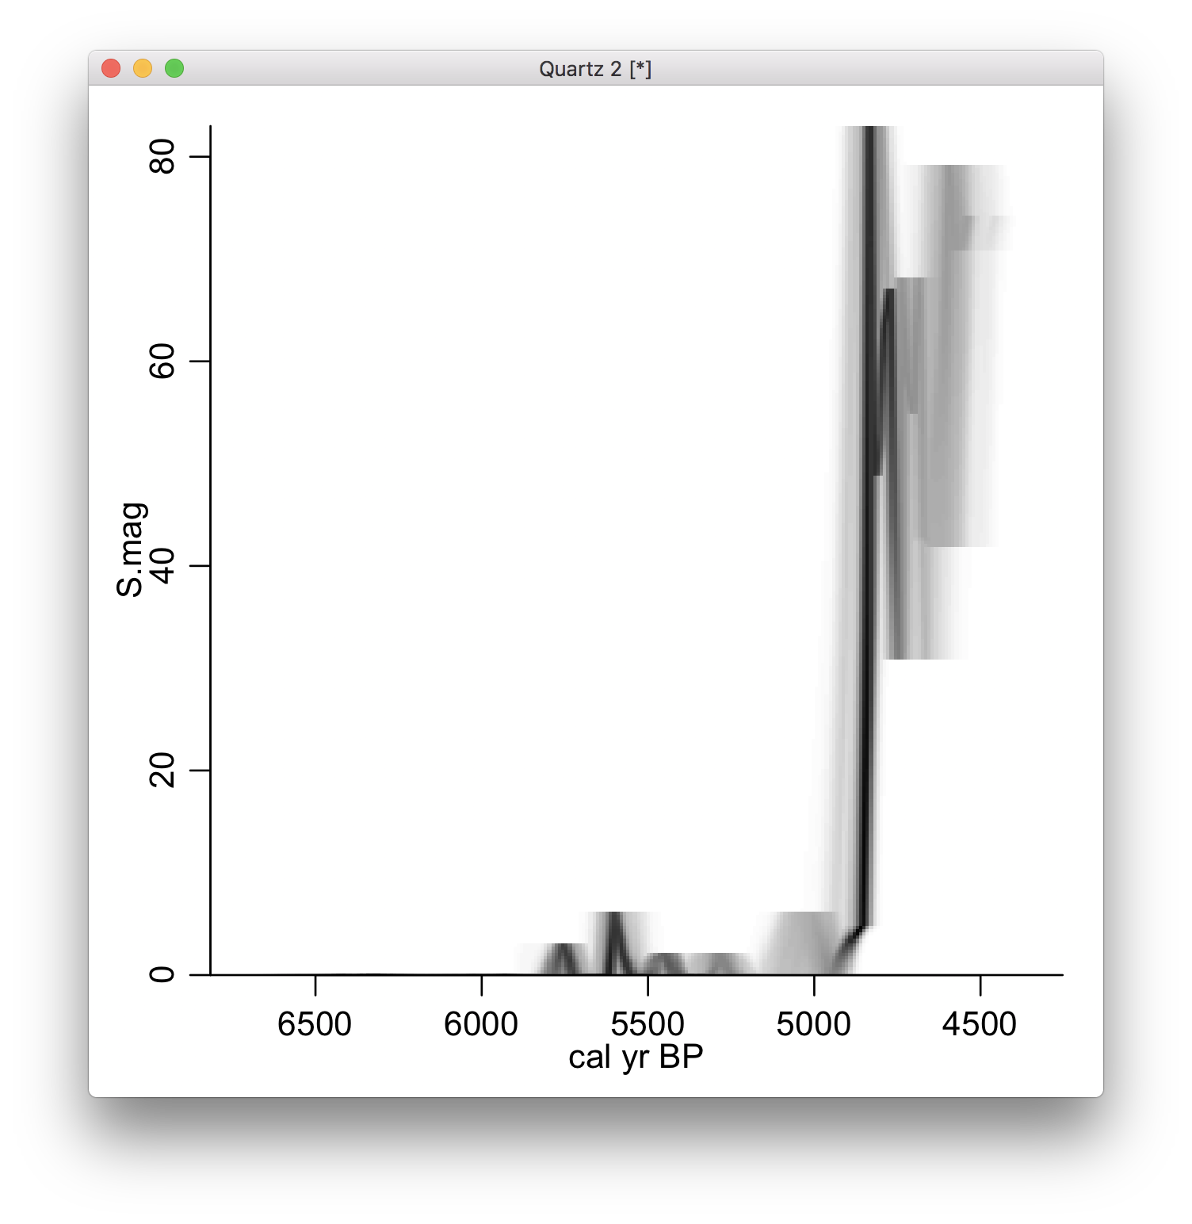
Bacon – post-run analysis
Plot a proxy against age (fourth proxy in MSB2K_proxies.csv:
Bacon(run=F)
agedepth()
layout(1)
proxy.ghost(4)

Slide 34
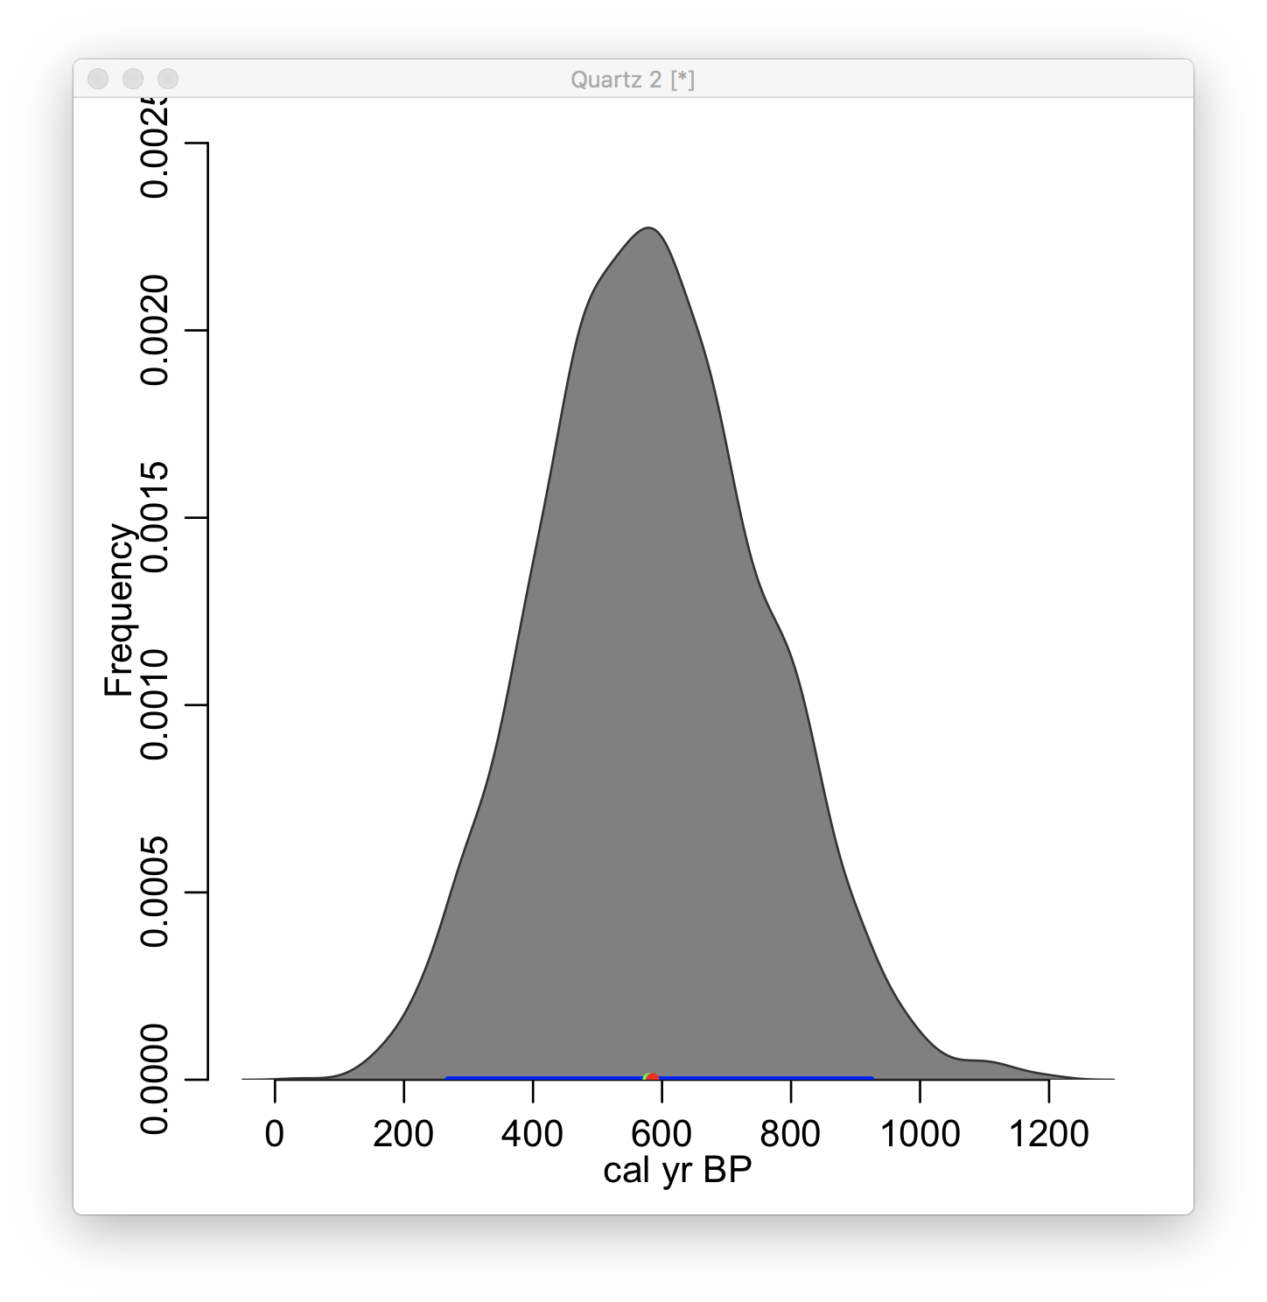
Bacon – post-run analysis
Plot the age estimate of a single depth:
Bacon.hist(20)
Or calculate time between depths:
d100 <- Bacon.Age.d(100)
d100
d50 <- Bacon.Age.d(50)
d100-d50
plot(d100-d50)
hist(d100-d50)

Slide 35
Pb-210 measurements (A) consist of background (red) and influx (blue)
Influx constant, remaining Pb depends on thickness slice and time passed
https://vimeo.com/548368871

Slide 36
Plum
Assume total Pb-210 (P^{T}) is normally distributed, so for a measurement pi:
This consists of both supported (P^{s}) and unsupported (P^{u}) Pb
Supported Pb P^{s} can either be constant or varying:
Pi^{T} = P^{s} + Pi^{u} or Pi^{T} = Pi^{s} + Pi^{u}
$p_{i}|P_{i}^{T}∝N\left(P_{i}^{T},σ_{i}^{2}\right)$
Aquino et al. 2018 JABES doi:10.1007/s13253-018-0328-7

Slide 37
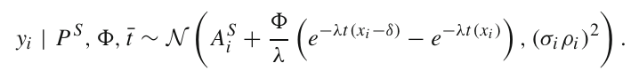
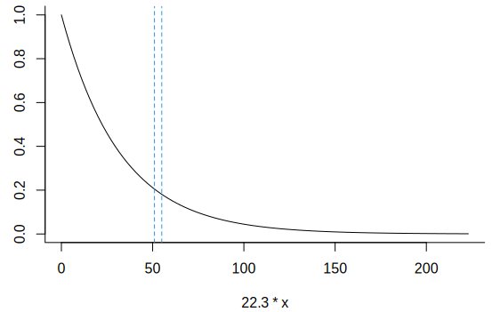
Plum
Now each measured slice depends on P^{s}, the influx, and the (Bacon) age assigned to the bottom and top depths of the slice:
Aquino et al. 2018 JABES doi:10.1007/s13253-018-0328-7

Slide 38
How to run Plum in R:
# install the package via R’s CRAN:
install.packages(‘rplum’)
# or a development version via github (updated more frequently, possibly less stable, so only for daredevils):
install.packages(‘devtools’)
require(devtools)
install_github(‘Maarten14C/rplum’)
# then load it and run the default core (accepting all suggestions with ‘y’):
require(rplum)
Plum()

Slide 39
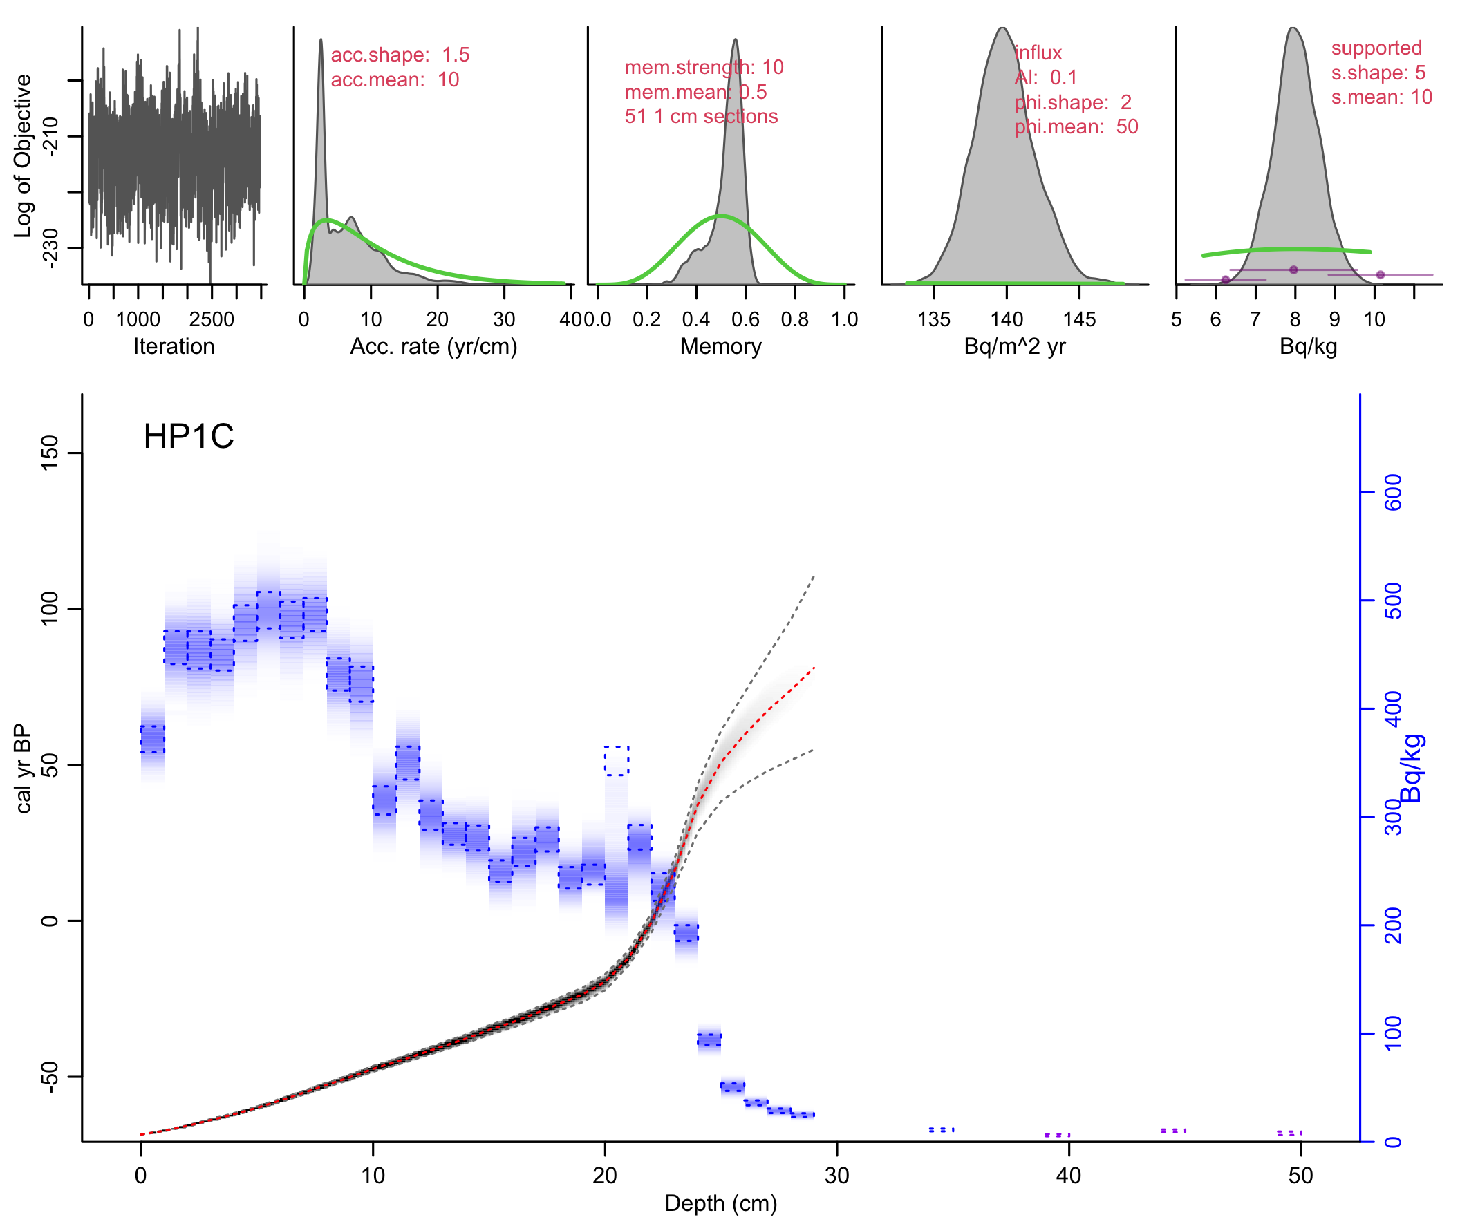
Plum()
Default core without ra measurements; supported ²¹⁰Pb estimated from tail ²¹⁰Pb measurements only.
Blue ²¹⁰Pb: measured in rectangles, modelled in “bluescale”.
Total ²¹⁰Pb modelled
All parameters involved in producing age-model and modelled ²¹⁰Pb

Slide 40
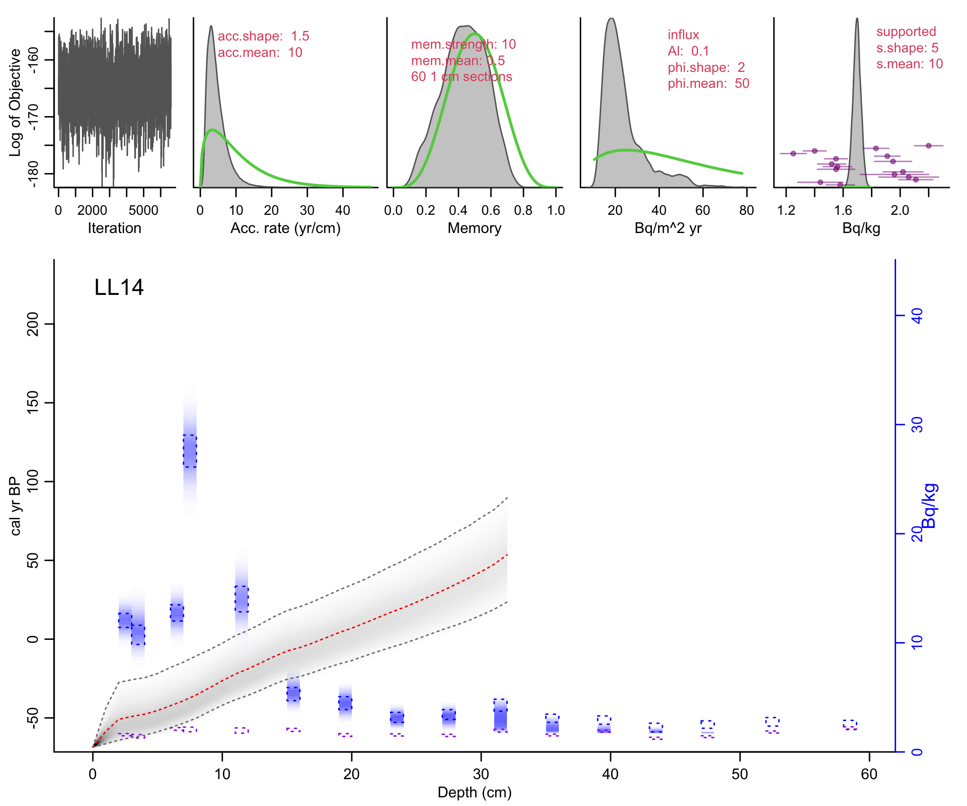
With ra-226 measurements as estimates of supported ²¹⁰Pb, either assuming that supported ²¹⁰Pb is constant along the core (ra case 1):
Plum(“LL14”, ra.case=1)

Slide 41
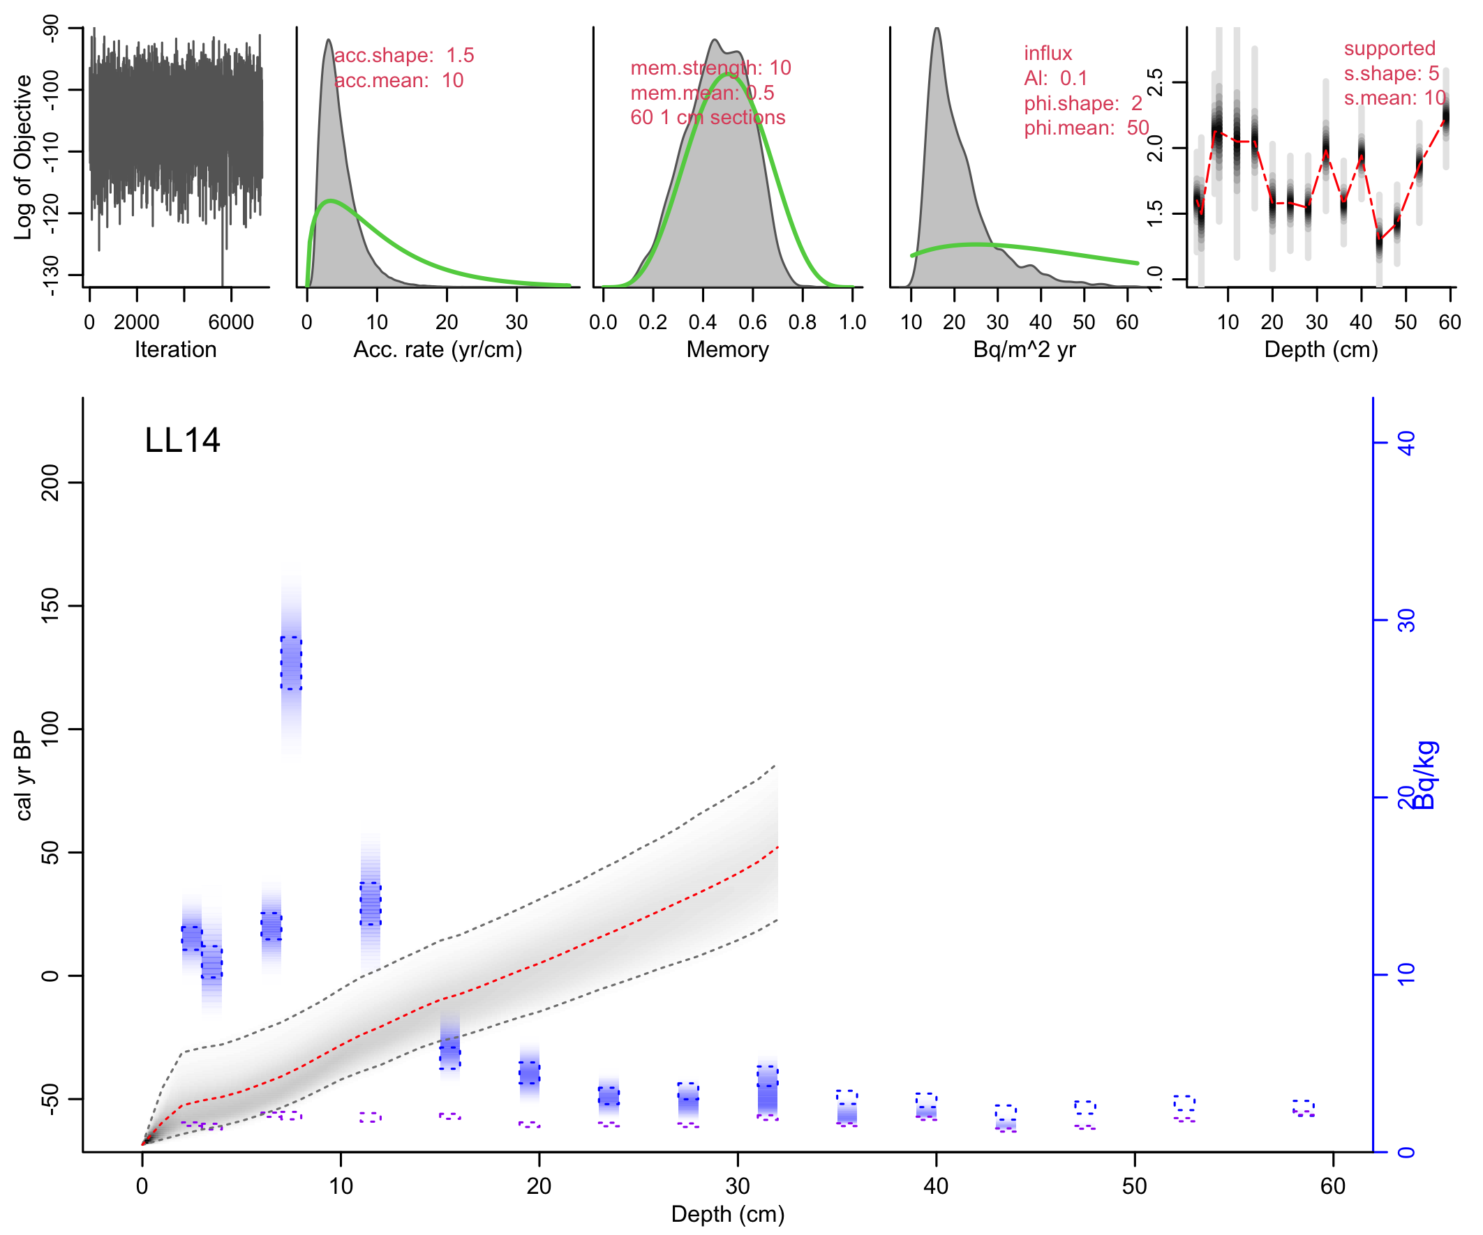
Or assuming that supported ²¹⁰Pb varies along with the ra-226 measurements (ra case 2; runs take longer as more parameters have to be estimated):
Plum(“LL14”, ra.case=2)

Slide 42
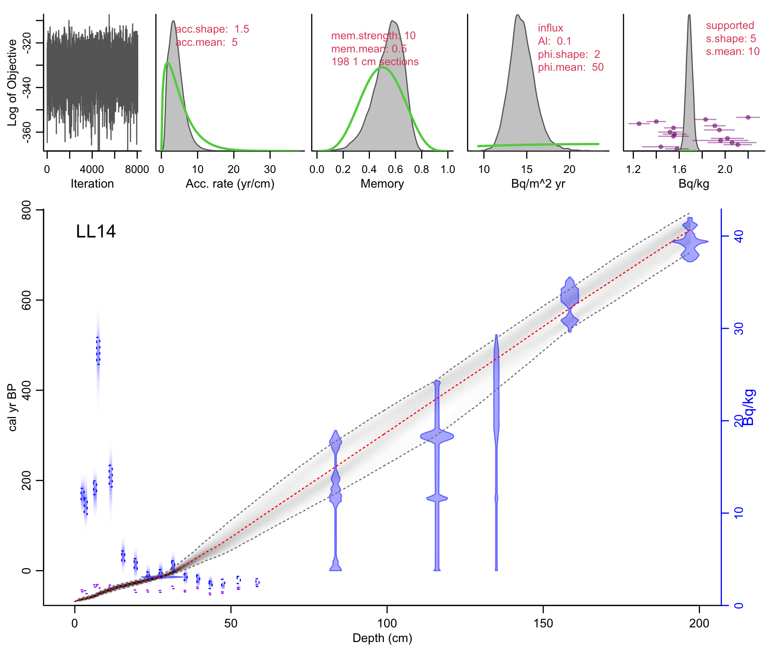
Plum’s age-depth model based on Bacon (piece-wise linear accumulation, constrained by prior information on accumulation rate and memory). Easy to include other dates such as radiocarbon or historical dates, by providing a Bacon file:
Plum(“LL14”, ra.case=1, otherdates=”LL14_14C.csv”)

